Slide 1
10 OPTICAL ILLUSIONS
SLIDESHOW
PLANB
WATCH FULL SCREEN. AUTOMATIC MODE
Read the corresponding blog here
daphne@depasse.nl

Slide 2


Slide 3



Slide 4
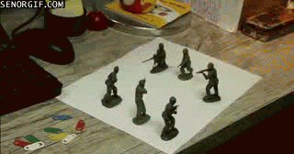

Slide 5
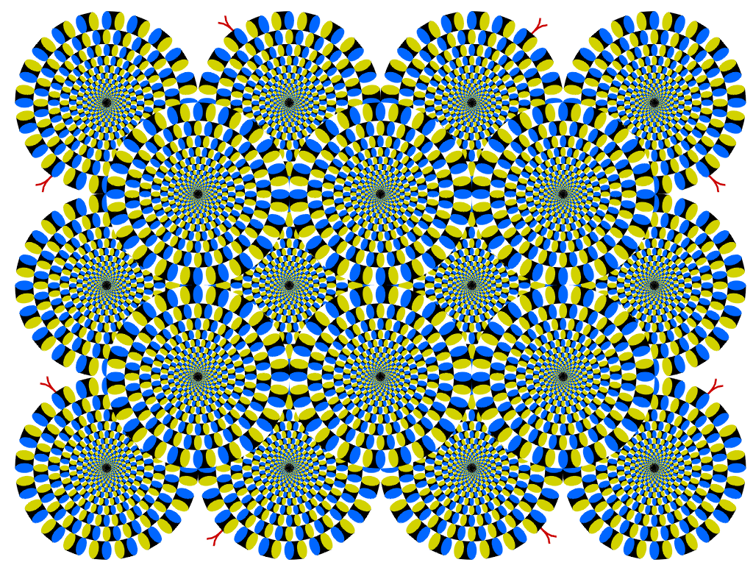


Slide 6
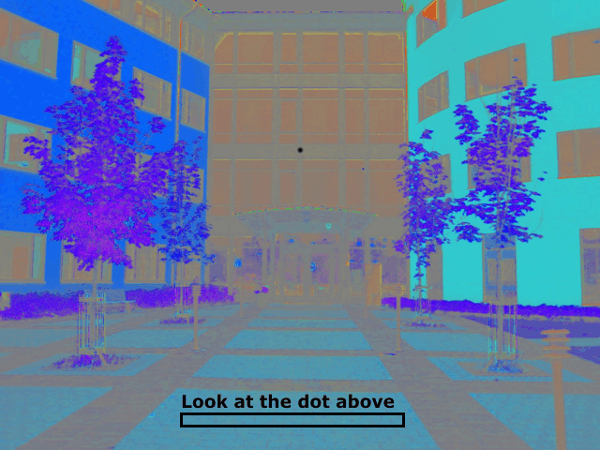


Slide 7
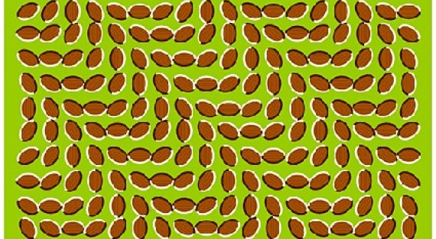

Slide 8
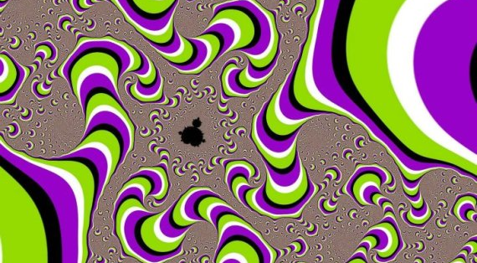

Slide 9
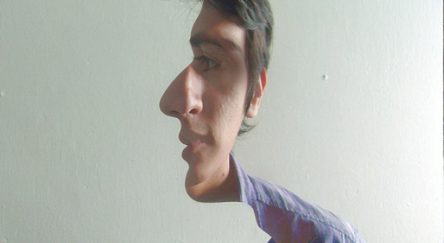

Slide 10
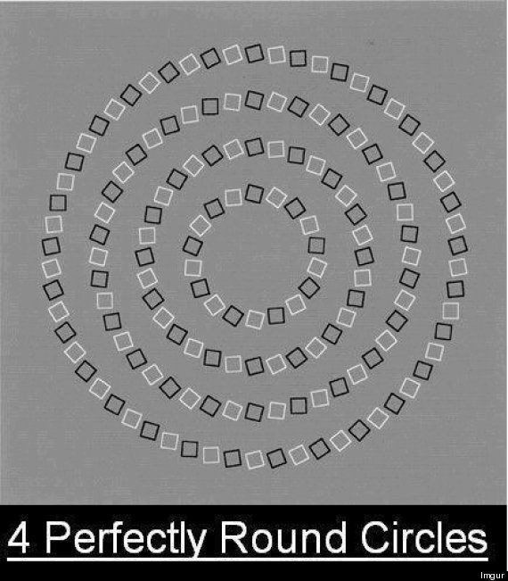

Slide 11
